Slide 1
Kinetic and Internal Energy
Chapter 1.1 page 4 - 9

Slide 2
KINETIC THEORY
Kinetic Theory states that the tiny particles in all forms of matter are in constant motion.
Solid: particles vibrate about a fixed position.
Liquids: particles move about a fixed position as the position itself moves about the liquid.
Gases: particles have sufficient kinetic energy to escape the attractive forces of other particles and move more freely.

Slide 3
KINETIC THEORY
Kinetic Theory applies where heating causes particles, within the material, to gain Kinetic energy (move or vibrate at greater speeds) and gain Potential energy (by moving further from their position of equilibrium).
This allows for a change in state to occur (solid → liquid → gas) where there is enough energy added to break the strong inter-particle forces.

Slide 4
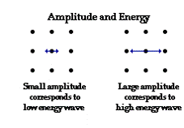
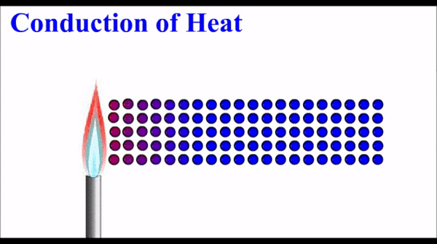
Kinetic and Potential Energy

Slide 5
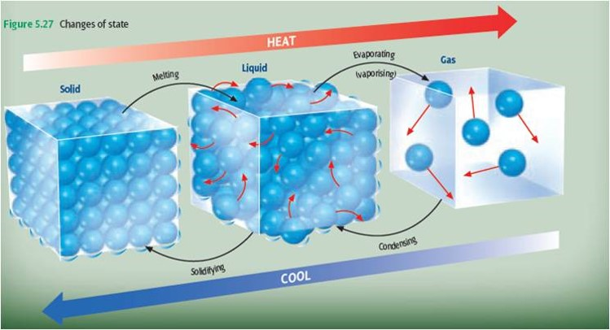
STATES OF MATTER

Slide 6
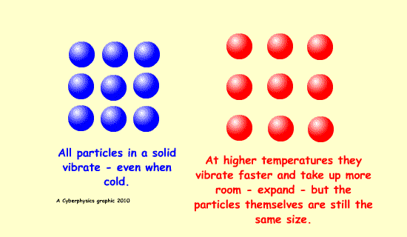
Expansion
An increase in temperature will cause the particles to vibrate more as the Kinetic Energy increases. This causes the particles to move further apart, hence the material expands when heated (gains energy) and
contracts when
cooled (loses
energy).

Slide 7
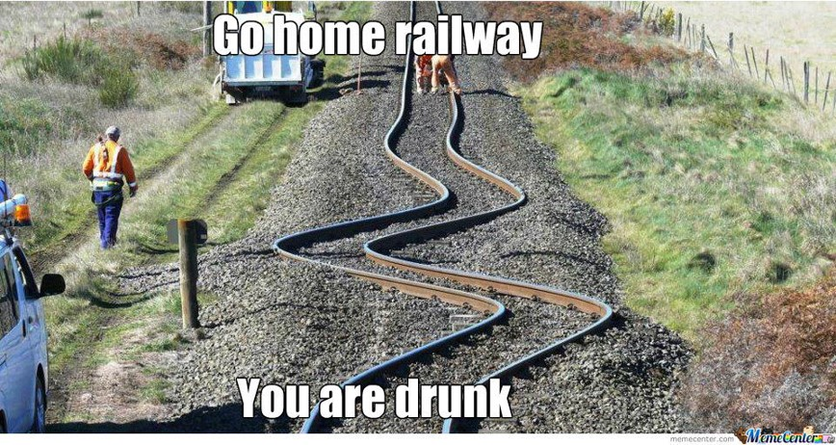
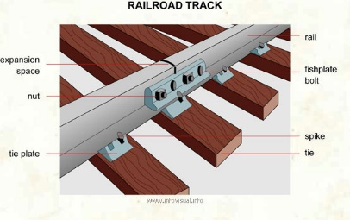
Expansion in Solids
Expansion in solids can cause structural damage if allowances are not made. Railway lines, for example, are not laid in one continuous strip, but have small gaps that allow for movement due to changes in temperature. The rails are connected with fishplates.

Slide 8
Heat, Temperature & Internal Energy
Temperature is the measure of the average kinetic energy of all the particles within the material or object.
Heat is the amount of energy transferred due to the difference in temperature.
Internal Energy is the total kinetic energy and potential energy

Slide 9
Homework, Context & Keywords
Homework
Complete all questions from Set 1.1 - due first lesson next week.
Read Chapter 1.2, page 10-13 and answer
Q1&2 Set 1.2
by next lesson.

Slide 10
Temperature and Thermal Equilibrium
Chapter 1.2 page 10 - 13

Slide 11
Temperature, Internal Energy and Heat Differences
Temperature is the degree or intensity of heat present in a substance or object, expressed in terms of any of several arbitrary scales like Celsius.
Internal energy is defined by the amount of kinetic energy available and the amount of potential energy stored within the isolated system.
Heat is energy that is transferred from one object to another as the result of a difference in temperature.

Slide 12
Temperature and Heat Differences
Hot drink in a cup versus a warm bath.
Temperature is higher in the hot drink since the average kinetic energy of particles is high.
Heat is transferred to the surroundings is greatest from the warm bath due to the greater surface area allowing the transfer of heat.

Slide 13
Absolute Temperature
Absolute Zero (0 Kelvin) = -273ºC
1 Kelvin increase = 1ºC increase
Formula: x K = 273 + y ºC
Example
Convert 26ºC to the equivalent Kelvin.
Convert 319 K to the equivalent Celsius

Slide 14
Heat
Heat is transferred or transformed.
Cold is not a form of energy.
Heat is the movement of thermal energy from a substance at a higher temperature to another substance at a lower temperature.
The ability to do work or cause change.
Hence is measured in Joules.

Slide 15
Calculations
Work = Force × Displacement (W = Fs)
Work (Joules)
Force (Newtons)
Displacement (Metres)
Power = Energy P = E
Time t
Power (Watts)
Energy (Joules)
Time (Seconds)

Slide 16
Example 1.2a
A family arrives home from holidays and switches on their 3.5 kW water heater, which heater, which contains 150 litres of water at 20ºC. How long will it be before the family can have a shower if the water needs to be 40ºC and the heat needed is 1.254 x 10⁷J?
Solution

Slide 17

Thermal Equilibrium
This is where two or more objects of different temperature are placed in an isolated system. The objects will gain or lose Kinetic energy to the other system, until both have an equal temperature.

Slide 18
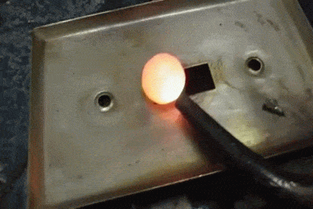
Fact
If a piece of hot metal is placed into a beaker of cold water, then the heat from the metal will transfer to the water.
The temperature of the water will rise and the temperature of the
metal will fall, until
thermal equilibrium
is reached.

Slide 19
Fact: Kinetic Theory
In terms of Kinetic Theory;
the average kinetic energy of the atoms of the metal has decreased and
the average kinetic energy of the atoms of the water has increased.

Slide 20
Fact: Thermal Equilibrium
In terms of equilibrium:
Heat lost by metal = Heat gained by water
(The final average Kinetic Energy of the particles for both water and metal will be the same)

Slide 21
Homework, Context & Keywords
Homework
Complete all questions from Set 1.2 - due first lesson next week.
Read Chapter 1.3, page 13-20 and answer
Q1 Set 1.3
by next lesson.

Slide 22
Specific Heat Capacity
Chapter 1.3 page 13-20
2 lessons

Slide 23
The specific heat capacity of a substance is the amount of heat required to raise the temperature of 1.0kg of that substance by 1.0 ºC.
To calculate the heat required to change the temperature of a substance, then;
Q = m c ∆T
Q = quantity of heat energy (J)
m = mass (kg)
c = specific heat (J kg⁻¹ K⁻¹)
∆T = temperature change (K)
Q = m c ∆T

Slide 24
The specific heat capacity of a substance is the amount of heat required to raise the temperature of 1.0kg of that substance by 1.0 ºC.
Specific heat is the energy (heat) required to raise the temperature of an object.
Example
Specific Heat Capacity of Water is 4180 J kg⁻¹ K⁻¹.
So the Specific Heat of a 2 kg amount of water is 2 × 4180 = 8360 J K⁻¹.

Slide 25
SOME SPECIFIC HEAT CAPACITIES
substance | c (J kg⁻¹ K⁻¹)
water
4180
ice
2100
copper
380
iron
435
aluminium
880
ethanol
2500
paraffin
2140
human body
3500
air
1010

Slide 26
Example 1.3a
A kettle is filled with tap water which is at a temperature of 22.0ºC. If the mass of the water is 1.85 kg, calculate the heat required to raise the temperature to 100ºC.
Solution

Slide 27
Example 1.3a
With the kettle boiling the water, what assumptions are made?
Solution

Slide 28
Example 1.3b
2 kW
immersion heater
What will be the temperature of the water after 2 minutes, given the specific heat capacity of water is 4200 J kg⁻¹ K⁻¹?
2000 g of water
At 20⁰ C
Solution

Slide 29
Example 1.3b
2 kW
immersion heater
In reality the final temperature would be lower than this. Why?
2000 g of water
At 20⁰ C
Solution

Slide 30
Example 1.3c
The two disk brakes of a 600 kg motorbike each have a mass of 1 kg. The motorbike brakes to a stop from 30 ms⁻¹. If 50% of the bike’s Kinetic energy is transferred to the disks, calculate their rise in temperature. c = 500 J kg⁻¹ K⁻¹?
Solution

Slide 31
Example 1.3d
A 0.650 kg block of copper metal is initially heated to 100 ºC (in boiling water), and then placed into 500 g of cold water at 15 ºC (without the boiling water).
Assuming no heat is lost to the surroundings, determine the final temperature of the copper and the water.
c_{c} = 390 J kg⁻¹ K⁻¹ c_{w} = 4180 J kg⁻¹ K⁻¹

Slide 32
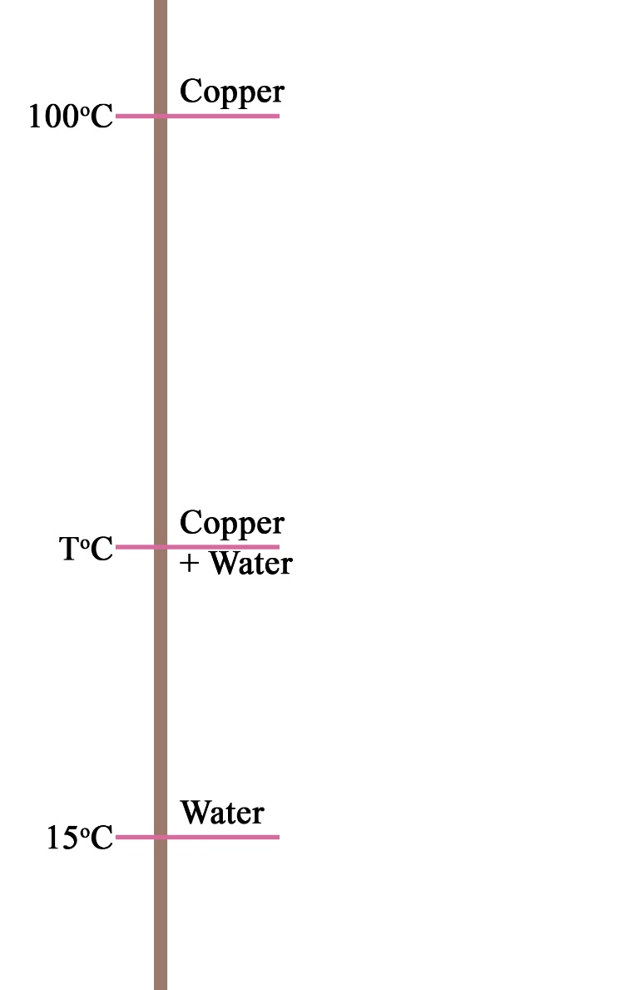
Example 1.3d
Step 1: Draw a diagram representing the information.

Slide 33

Example 1.3d
Step 2: Apply vector to the change in temperature component of the diagram.

Slide 34
Example 1.3d
Step 3: Understanding thermal equilibrium.
Heat loss by copper + Heat gained by water = 0
This states that the loss + gain must equal out

Slide 35
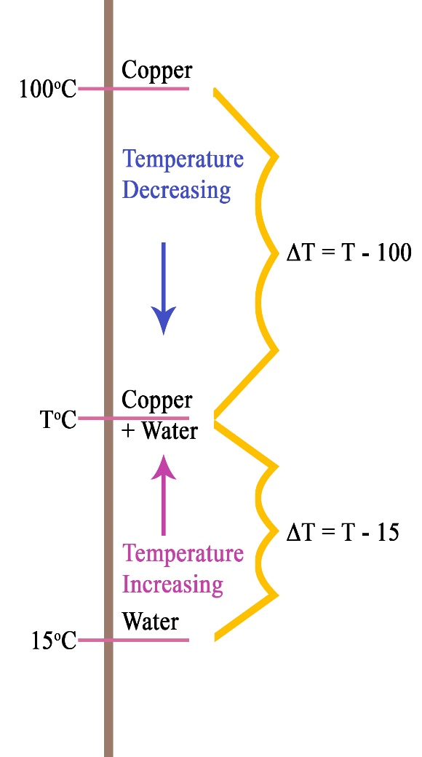
Example 1.3d
Step 4: Apply the thermal equilibrium equation.
Solution

Slide 36
RADIATOR
Why is Water used as the coolant?
Because water has a high specific heat capacity, it can take away a lot of energy without boiling away.

Slide 37


Scuba Diver
A scuba diver in the sea is surrounded by water colder than they are. Water has a specific heat capacity of 4180 J kg⁻¹ K⁻¹.
A scuba diver on land is surrounded by air colder than they are. However air has a specific heat capacity of 1010 J kg⁻¹ K⁻¹.
Assuming the mass of the person is unchanged and the temperature of the water and the air are the same. Hence the only factor different is the specific heat capacity. Since water is 4 times greater, hence the energy removed from the person in the water 4 times more.

Slide 38
Example 1.3e
What happens when the system is not fully isolated.
Example
200 g of water at 10⁰C is added to 400 g of water at 50⁰C that is already sitting in an a 200 g metal can of specific heat capacity 400 J kg⁻¹ K⁻¹. What will be the temperature of the water immediately after thorough mixing has occurred?
Assumptions

Slide 39
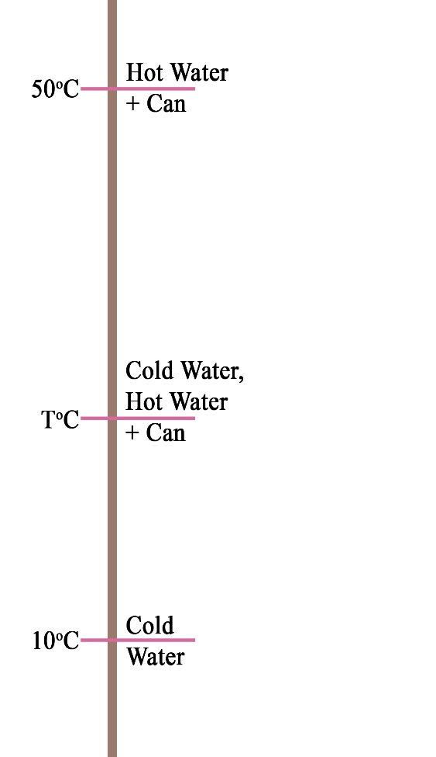
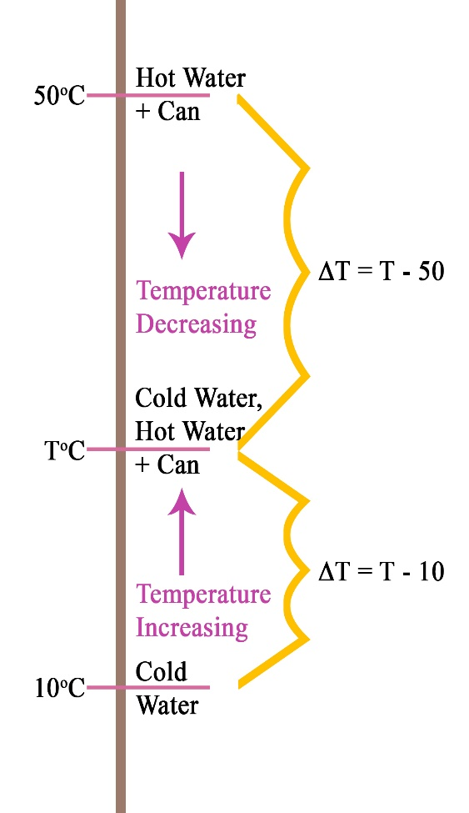
Example 1.3e
C_{can} = 400 J kg⁻¹ K⁻¹ and C_{water} = 4180 J kg⁻¹ K⁻¹
Solution

Slide 40
Homework, Context & Keywords
Homework
Complete all questions from Set 1.3 - due first lesson next week.
Read Chapter 1.4, page 20-30 and answer
Q1,2&3 Set 1.4
by next lesson.

Slide 41
Latent Heat
Chapter 1.4 page 20-30
2 lessons

Slide 42
Latent Heat
Latent heat is where energy (heat) is continually applied to the body, however, instead of a change in temperature occurring, there is a change in state.
The applied heat is absorbed by the particles, as potential energy, as they move further apart from each other.

Slide 43
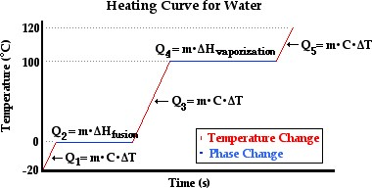
Ice ↔ Water ↔ Steam

Slide 44
Latent Heat of….
The Latent Heat of Fusion is the amount of heat (energy) required to convert 1 kg of a Solid completely into a Liquid (or a Liquid into a Solid), without a change in temperature occurring.
The Latent Heat of Vaporisation is the energy required to convert 1 kg of a Liquid completely into Vapour (or Vapour into Liquid), without a change in temperature occurring. This is known as the Boiling Point of the Liquid, and is tallied at the Standard Atmospheric Pressure.

Slide 45
Latent Heat Formula
Q = mL
Q = energy (J)
m = mass (kg)
L = specific latent heat (J kg⁻¹)
Water L_{fusion} = 3.34 x 10⁵ J kg⁻¹
L_{vaporisation} = 2.26 x 10⁶ J kg⁻¹
Q = mL

Slide 46
Example 1.4a
A 2 kW kettle holds 2 litres of water, initially at 20 ⁰C. How long will it be before a quarter the water has boiled away, assuming that there are no heat losses?
Solution
Step 1:

Slide 47
Example 1.4a
A 2 kW kettle holds 2 litres of water, initially at 20 ⁰C. How long will it be before a quarter the water has boiled away, assuming that there are no heat losses?
Solution
Step 2:

Slide 48
Example 1.4b
A basket-baller attains a high metabolic rate during a game and much of the excess heat generated must be lost bt sweating. During such a game Andrew develops excess heat at a rate of 800 W. If 90% of this heat must be lost by sweating, calculate the mass of the sweat produced in a 10 minute session. Assume the Latent Heat of sweat is 2.4 x 10⁶ J kg⁻¹.
Solution

Slide 49
Example 1.4b

Slide 50
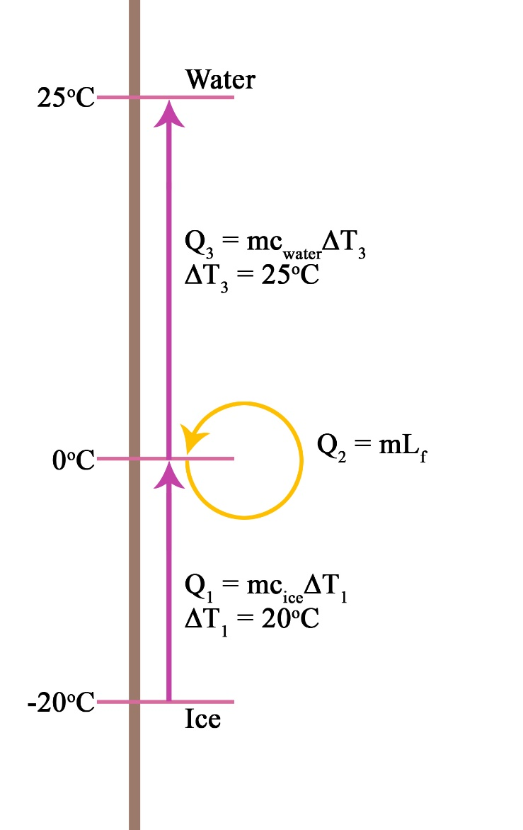
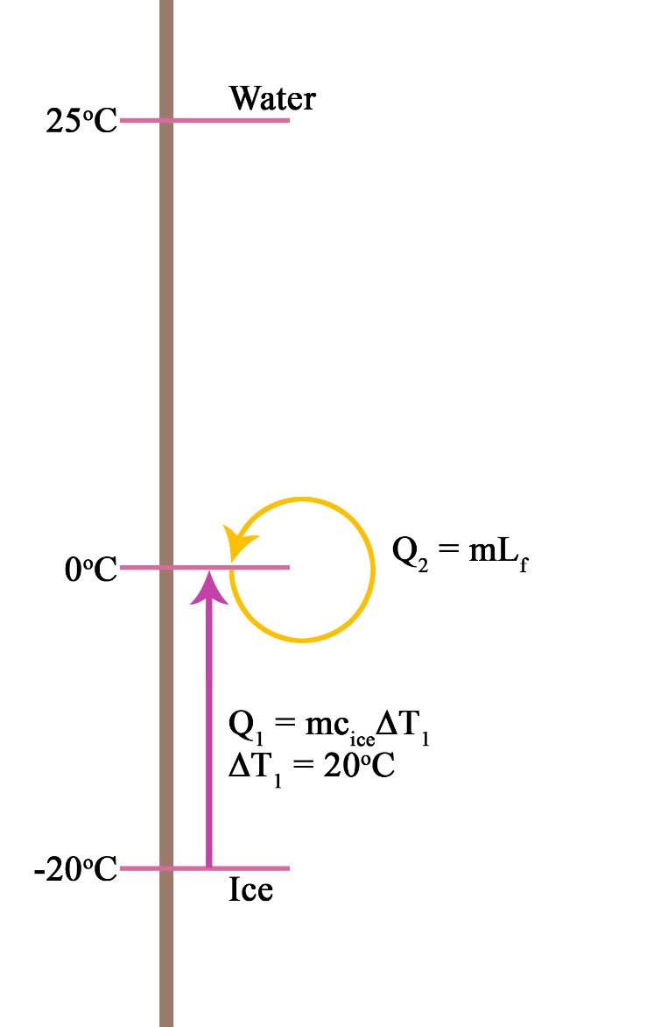
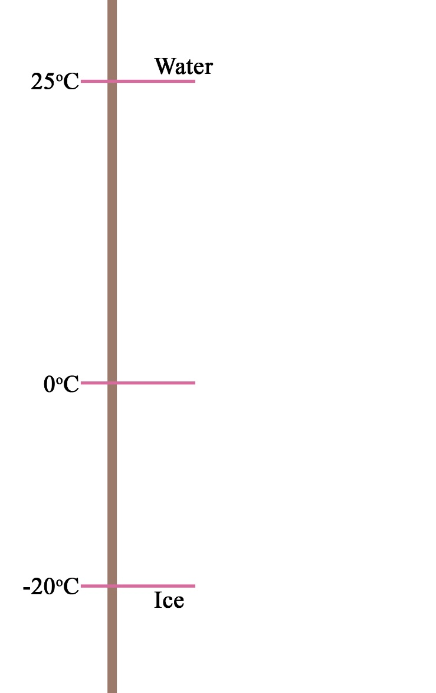
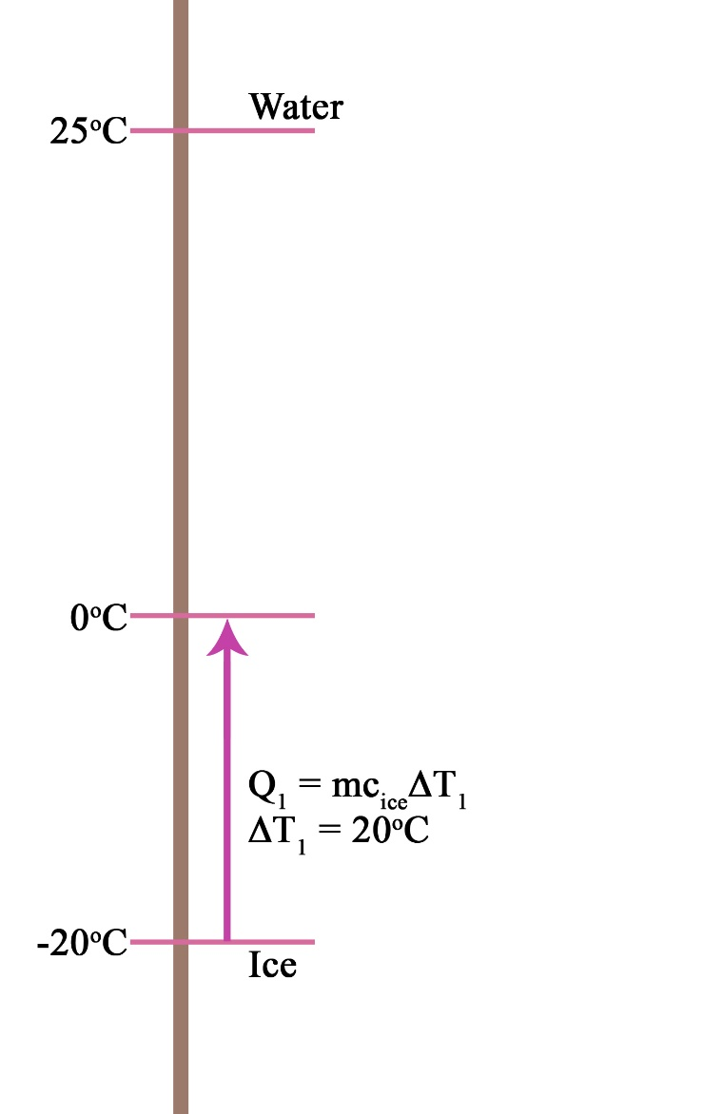
Example 1.4c
Determine the amount of energy required to change 250g of ice at -20 ºC to water at 25 ºC.

Slide 51
Example 1.4d
In order for Silver to bind uniformly with copper to make Sterling Silver, it must first be brought to a gaseous state and then cooled. How much energy is required to get 6.4 kg of Silver to a gaseous state from room temperature (22 ºC) given the following data on Silver.
Melting Point of Silver = 961 ºC
Boiling Point of Silver = 2193 ºC
Latent Heat of Fusion of Silver = 8.8 x 10⁴ J kg⁻¹
Latent Heat of Vaporisation of Silver = 2.3 x 10⁶ J kg⁻¹
Specific Heat of Silver in Solid State = 2.3 x 10² J kg⁻¹ K⁻¹
Specific Heat of Silver in Liquid State = 14 J kg⁻¹ K⁻¹

Slide 52
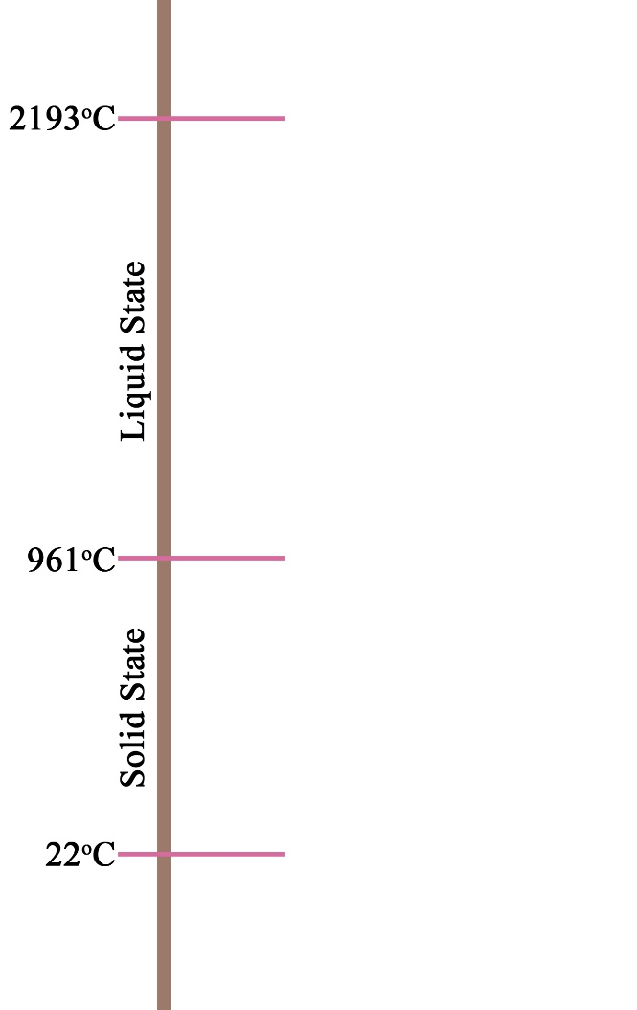
Example 1.4d
m = 6.4kg

Slide 53
Homework, Context & Keywords
Homework
Complete all questions from Set 1.4 - due first lesson next week.
Read Chapter 2.1, page 36-44 and answer
Q1&2 Set 2.1
by next lesson.
Chapter 1 Review questions page 33 – 34 due first lesson next week.

Slide 54
Conduction Convection and Radiation
Chapter 2.1 page 36-44
2 lessons

Slide 55
The Nature of Heat
Heat moves in only one direction:
Under normal conditions and in nature, heat energy will ALWAYS flow the warmer object to the cooler object.
Heat energy will flow from one substance to another until the two substances have the same temperature (are in equilibrium).

Slide 56
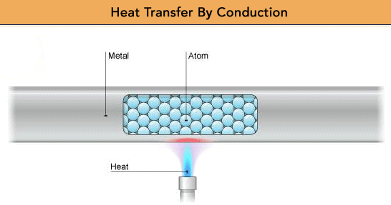
Conduction
Conduction is the transfer of thermal energy through the direct contact of particles.

Slide 57
Conduction
The faster moving particles in the warmer section collide with the slower moving particles in the cooler section.
As they collide, they give up some of their energy to the slower moving particles.
The slower moving particles gain thermal energy and pass it along to other particles.
Solids are better conductors than liquids, and liquids are better conductors than gases.

Slide 58
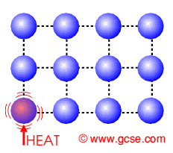
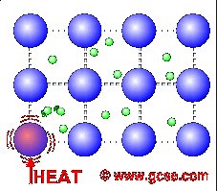
Conduction and Metals
The outer electrons of metal atoms drift, and are free to move.
When the metal is heated, this ‘sea of electrons’ gain kinetic energy and transfer it throughout the metal.
Insulators, such as wood and plastic, do not have this ‘sea of electrons’ which is why they do not conduct heat as well as metals.

Slide 59
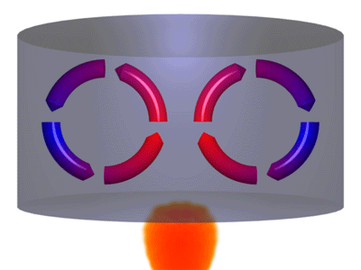
Convection
Convection is the transfer of thermal energy through currents.
Convection occurs in liquids and gases.
As liquids and gases gain thermal energy, they expand and decrease in density.

Slide 60
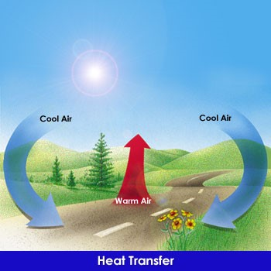
Convection

Slide 61
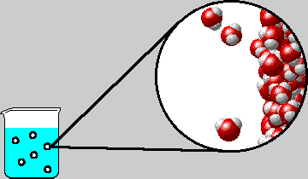
Evaporation has a cooling effect. How?
The more energy in a particle, the more it oscillates from its point of equilibrium making the spacing between the particles greater. This makes the particle less dense.
The faster moving particles (of high Kinetic energy) make their way to the surface (or their energy transfers
its way to the surface) and they
break free.
Molecules with high Kinetic
energy leave the liquid.

Slide 62
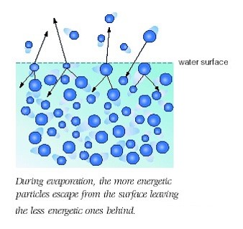
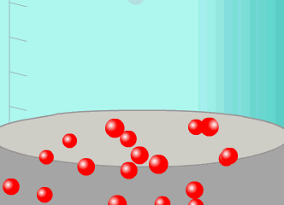
Evaporation has a cooling effect. How?
The average Kinetic Energy of the liquid drops during evaporation.
NOTE: Not all particles within the liquid have the same Kinetic Energy. This is why temperature is the measure of the average kinetic energy.

Slide 63
Radiation
The transfer of (thermal) energy by electromagnetic waves.
Radiation does not require matter to transfer thermal energy.
All the sun’s energy that reaches Earth travels through millions of kilometers of empty space (a vacuum).
All matter can radiate energy.
You feel the radiation of thermal energy from a bonfire, a heat lamp and a light bulb.

Slide 64
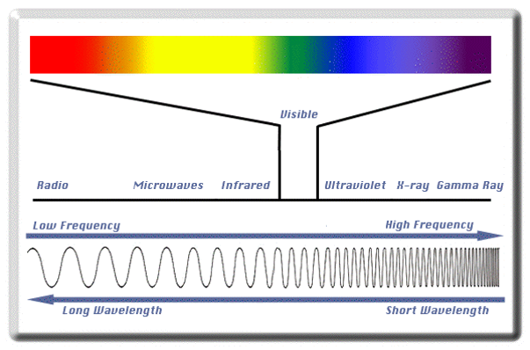
Radiation

Slide 65
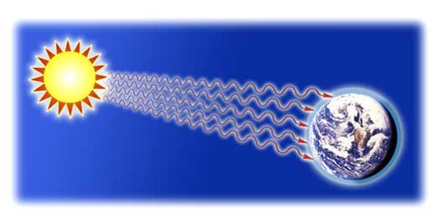
Radiation

Slide 66
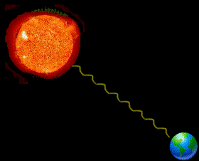
Radiation
The Sun is a major source of heat energy on Earth.
Have you ever wondered how the Sun warms us? Radiation from the Sun travels easily through space and when it reaches the Earth, it warms the ground and the air by converting potential energy to kinetic energy of the particles on Earth.
The Sun is not the only thing that gives out radiation. All objects give out radiation including humans.

Slide 67
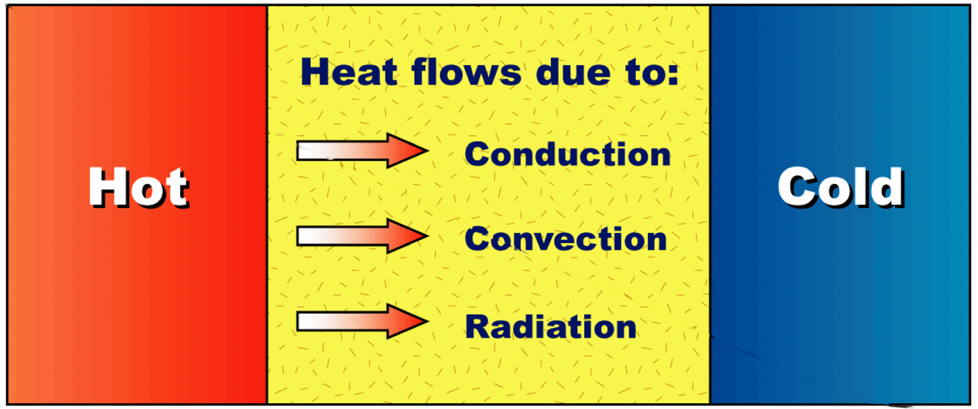
Heat transfer
Heat energy always moves from a warmer object to a cooler object. This flow of heat is called heat transfer.
There are three ways in which heat energy can be transferred:
Conduction – the passing of heat from the warmer end of an object to a cooler end.
Convection – the movement of heated particles in a liquid or gas from a warmer area to a cooler area.
Radiation – the emission of particles or waves from a warm object, e.g. the Sun.

Slide 68
Conduction
Radiation
Convection
Direct contact of particles
Solids/liquids/gases
The handle of a cooking utensil
Transfer of energy by waves
Only radiant energy that is absorbed becomes thermal energy
Lightbulb
Fireplace
Transfer of energy by bulk movement of matter (fluids)
Currents (wind,water)
Hot air balloon

Slide 69
Homework, Context & Keywords
Homework
Complete all questions from Set 2.1 - due first lesson next week.
Read Chapter 2.2, page 45-47 and answer
Q1&2 Set 2.2
by next lesson.

Slide 70
Conservation and Efficiency
Chapter 2.2 page 45-47

Slide 71
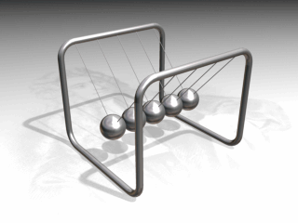
Conservation of Energy
Law of Conservation of Energy states: every is neither created nor destroyed, however it is transferred or transformed.

Slide 72
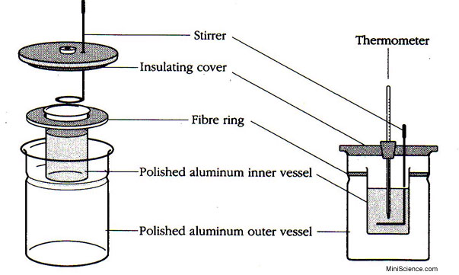
Closed System
Closed systems are systems isolated from
their environment. Example is a calorimeter.

Slide 73
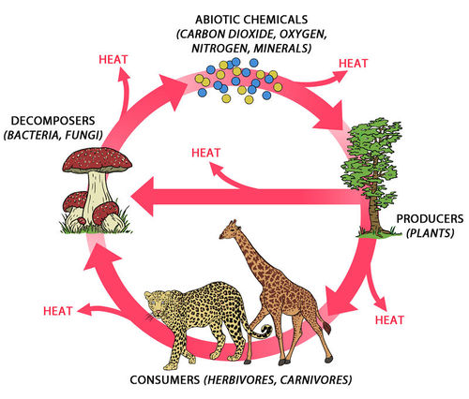
Open System
Open systems are systems that allow energy to move across boundaries.

Slide 74
Energy Efficiency (Ƞ)
Ƞ = energy output × 100%
energy input
= useful work output × 100%
total work input
NOTE: Objects releasing or obtaining heat are usually experiencing high inefficiencies

Slide 75
Example 2.2 a
A motor car engine converts the chemical energy stored in petrol into heat and mechanical energy. Typically, it converts 35 MJ of energy for each litre of petrol consumed. On average, for a particular car, 25 MJ of this energy is given up as heat losses, mainly through the radiator and hot exhaust gases. The remainder provides the mechanical energy to keep the car moving.
Write out the parameters.
Solution

Slide 76
Example 2.2 a
Input energy = 35 MJ,
Heat losses = 25 MJ
Output energy = 10 MJ
Calculate the efficiency of this car in providing mechanical energy.
Typically, due to other internal losses, such as drive train friction, only 90% of the mechanical energy provided by the motor is available as power to the wheels. Calculate the overall efficiency of the car in providing energy of movement.
The cars manufacturer quotes a fuel consumption of 12.0 L of petrol per 100 km. Calculate how much energy is supplied to power the wheels for each kilometre of travel.

Slide 77
Example 2.2 a
Input energy = 35 MJ,
Heat losses = 25 MJ
Output energy = 10 MJ
Calculate the efficiency of this car in providing mechanical energy.
Solution

Slide 78
Example 2.2 a
Input energy = 35 MJ, Heat losses = 25 MJ
Output energy = 10 MJ, Ƞ = 28.6 %
Typically, due to other internal losses, such as drive train friction, only 90% of the mechanical energy provided by the motor is available as power to the wheels. Calculate the overall efficiency of the car in providing energy of movement.
Solution

Slide 79
Example 2.2 a
Input energy = 35 MJ, Heat losses = 25 MJ
Output energy = 10 MJ, Ƞ_{motor} = 28.6 %, Ƞ_{wheels} = 25.7 %
The cars manufacturer quotes a fuel consumption of 12.0 L of petrol per 100 km. Calculate how much energy is supplied to power the wheels for each kilometre of travel.
Solution

Slide 80
Homework, Context & Keywords
Homework
Complete all questions from Set 2.2 - due first lesson next week.
Read Chapter 2.3, page 48-50 and answer
Q1,2&3 Set 2.3
by next lesson.

Slide 81
Energy Efficient Houses
Chapter 2.3 page 48-50

Slide 82
Homework, Context & Keywords
Homework
Complete all questions from Set 2.3 - due first lesson next week.
Read Chapter 2.4, page 50-59 and answer
Q1&2 Set 2.4
by next lesson.

Slide 83
Energy Efficient Earth
Chapter 2.4 page 50-59

Slide 84
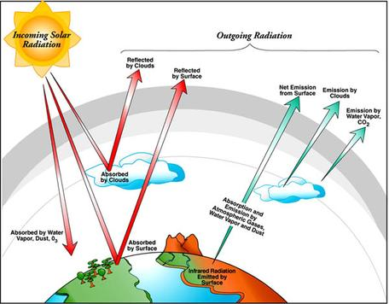
Earths Energy Balance

Slide 85
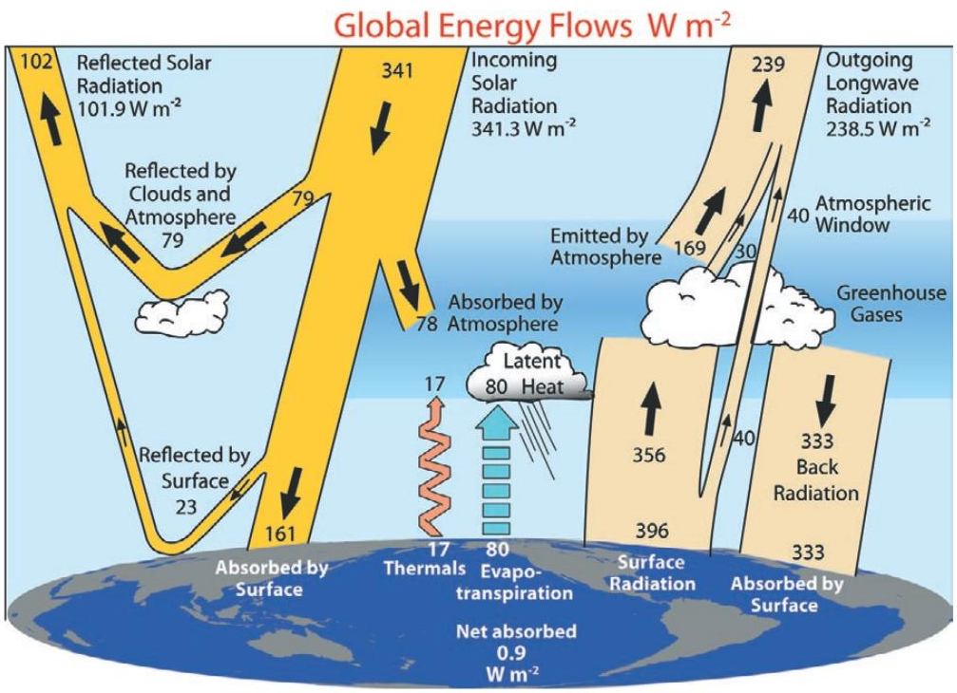
Earths Energy Balance

Slide 86
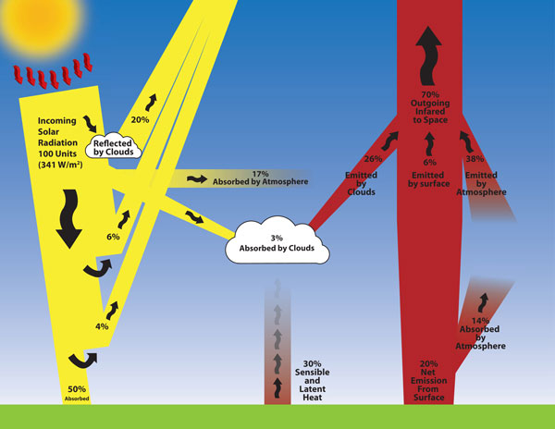
Earths Energy Balance

Slide 87

ONSHORE AND OFFSHORE BREEZES
By day the land heats up faster than the sea.
The land has a lower specific capacity than the water.
The land heats the air from below and convection currents rise
This drags in cooler air from over the sea – On Shore Breeze
The reverse happens by night

Slide 88
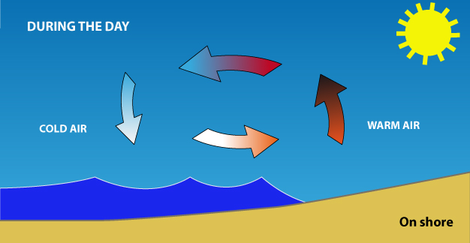
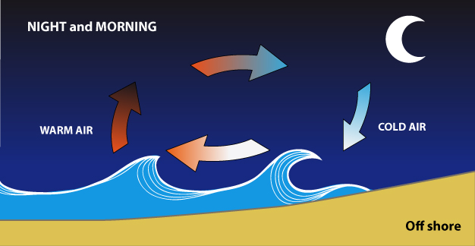
Sea Breeze and Fremantle Doctor

Slide 89
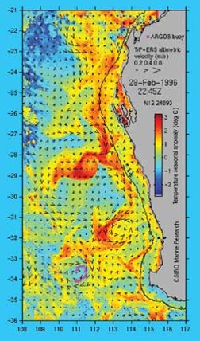
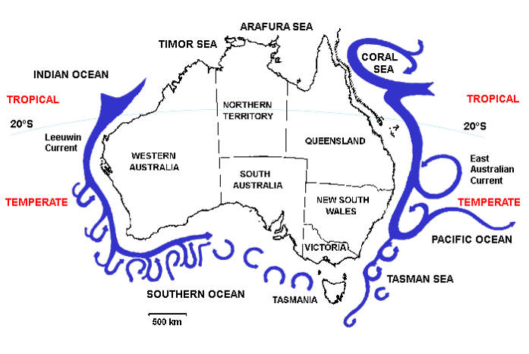
This satellite image shows surface ocean temperatures for West Australian waters. The warm Leeuwin Current brings tropical waters and marine fauna down the Western Australian coast.
Water in along the Perth region starts off at between 22 and 27⁰C.
Because water has a high specific heat capacity, it takes a long time to cool.
Even in winter the seas to the west of the Perth region are rarely below 20⁰C.

Slide 90
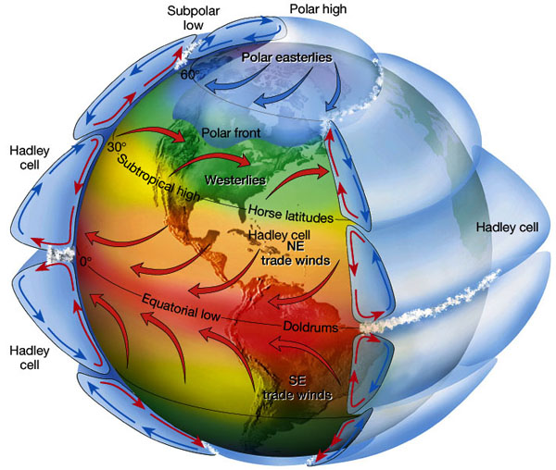
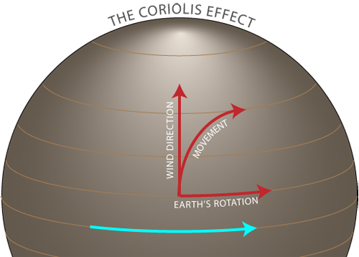
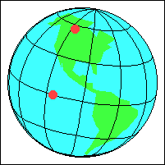

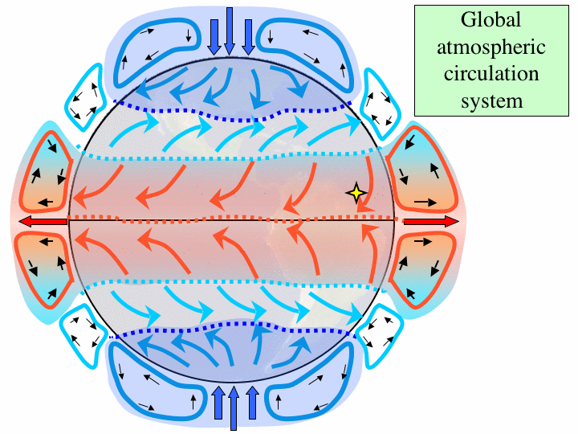
Coriolis Effect

Slide 91
Homework, Context & Keywords
Homework
Complete all questions from Set 2.4 - due first lesson next week.
Read Chapter 2.5, page 60-67 and answer
Q1&2 Set 2.5
by next lesson.

Slide 92
Work, Heat and Energy
Chapter 2.5 page 50-59

Slide 93
Calculations
Work = Force × Displacement (W = Fs)
Work (Joules)
Force (Newtons)
Displacement (Metres)
Power = Energy P = E
Time t
Power (Watts)
Energy (Joules)
Time (Seconds)

Slide 94
Example 2.5a
On a camping trip a family is boiling 3 L of water, initially at 20 ºC. The son suggests that the family use the gas stove instead of the wood fire, because the gas stove has a 5 kW output. The father decides to keep the water on the fire, noting it takes 5 minutes to boil. Who was correct?
Solution

Slide 95
Homework, Context & Keywords
Homework
Complete all questions from Set 2.5 - due first lesson next week.
Read Chapter 2.6, page 68-69 and answer
Q1&2 Set 2.6
by next lesson.

Slide 96
Low Temperature Devices
Chapter 2.6 page 68-69

Slide 97
Low Temperature
Superfluid – zero viscosity, allowing it to move through any pores of a substance.
Superconductor – zero resistance, usually occurs when a material reaches it’s critical temperature.

Slide 98
Homework, Context & Keywords
Homework
Complete all questions from Set 2.6 - due first lesson next week.
Chapter 2 Review questions page 72 due first lesson next week.
Semester 1 is completed.

